Slide 1
Pathological innovation to support Aatma Nirbhar Bharat
By:
Laxmi Pasi
Harshita Tripathi
Harsh Pathak
Nishit Thakkar
Ved Suthar
Parth Desai
Mentor:
Prof. Sejal Thakkar

Slide 2
Problem Statement
Currently the remote farmer working in COVID situation can have trouble sampling their plant/crop’s health which can turn into poor yield.
So an on-site disease classification using AI and simple tools can help them identify the diseased plant/crop easily.
Using real time images, and quick classification on remote place to get the info about plant’s health.

Slide 3
Introduction
During these challenging times, how does Indian Agriculture respond to the crisis and how do government measures affect 140 million farm households across the country and thereafter impact the economy of a very important country in the developing world? We assess the immediate challenges that COVID19 has posed to the farm sector and suggest mitigation measures to ensure a sustainable food system in the post-crisis period.
As weather has been very erratic over past few months in many parts, harvested produce must also be protected from such risks.

Slide 4
Introduction
Plant diseases can cause significant reduction in both quality and quantity of agricultural products. Automatic detection of plant diseases is an essential research topic as it may prove benefits in monitoring large fields of crops.
An android application which scans and detect plant name and further it predicts disease if present using machine learning model(CNN) on the site.

Slide 5
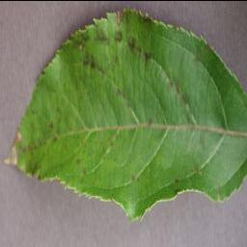
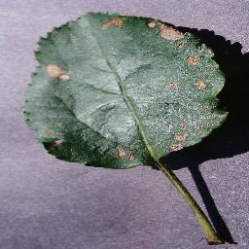
Observation : Disease in plants
Scab
Black Rot

Slide 6
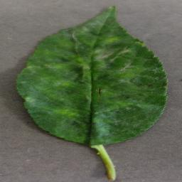
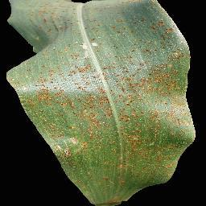
Observation : Disease in plants
Powdery Mildew
Common Rust

Slide 7
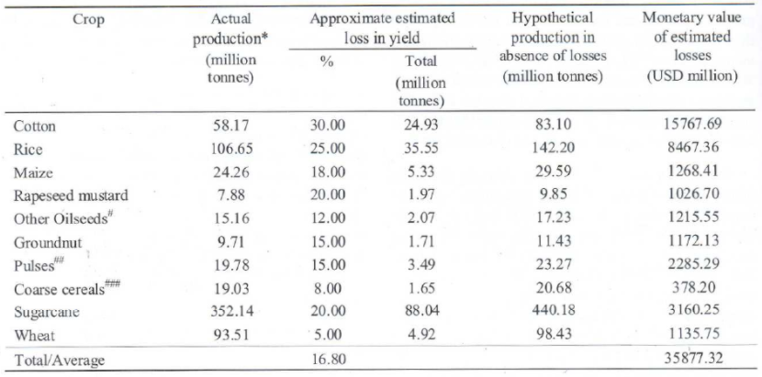
Observation : Effects

Slide 8
Literature Review
Title | Author | Review
Using Deep Learning for Image-Based Plant Disease Detection | Sharada P. Mohanty, David P. Hughes and Marcel Salathé | Not enough image processing done
Artificial Intelligence-Based Plant’s Diseases Classification | Lobna M. Abou El-Maged, Ashraf Darwish, Aboul Ella Hassanien | Using VGG16 architecture. And Gaussian Optimization Method
https://towardsdatascience.com/plant-ai-plant-disease-detection-using-convolutional-neural-network-9b58a96f2289 | Oluwafemi Tairu | Using CNN for ML model

Slide 9
Research gap
Mainly in every research they miss out pre-processing, where they correct the image given as input to the model.
Classifying the disease directly can also cause wrong plant classification like instead of Pepper Bell Bacterial spot, it could give a false positive on Peach Bacterial spot.
The dataset used is generally very small while most of the research done is either on single disease or a single plant.

Slide 10
Dataset Info
The data we use is collection of many different datasets that are publically available and some real time images that we captured on the crop field.
Approx. count : 90,000 images
Tomato: Bacterial spot, Early blight, Late blight, Mold, Septoria leaf spot, Spider mites,Two spotted spider mite, Target Spot , Mosaic virus, Yellow Curl Virus, Healthy
Potato: Early blight, Late blight,healthy.
Apple: Apple scab, Black rot, Cedar apple rust, healthy
Grape: Black rot, Esca, Leaf blight, Healthy

Slide 11
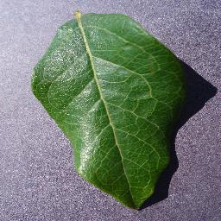
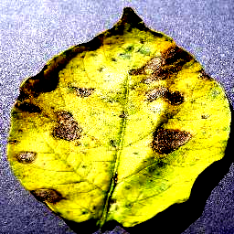
Dataset Info
Corn: Gray leaf spot, Common rust, Northern leaf blight, Healthy
Cherry: Powdery Mildew, Healthy
Pepper Bell: Spots, Healthy
Strawberry: Leaf Scorch, Healthy
Rice: Unhealthy, Healthy
Castor: Spots, Healthy

Slide 12




Technologies Used
CV2 : OpenCV is a library of programming functions mainly aimed at real-time computer vision.
Tensorflow and keras : TensorFlow is a free and open-source software library for machine learning.
Android (Java) : Android is a mobile operating system based on a modified version of the Linux kernel.
Django is a Python-based free and open-source web framework that follows the model-template-views architectural pattern.

Slide 13
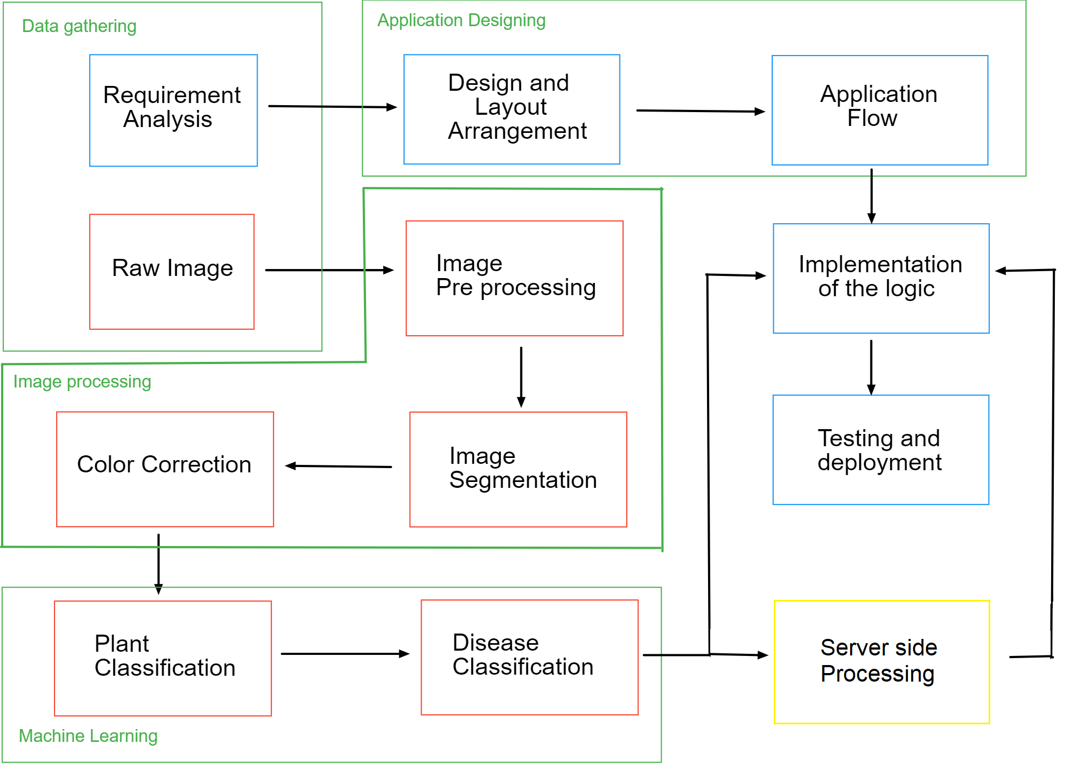
Flow Chart

Slide 14
Data gathering and analysis
The crops that are grown in India.
The disease that occur frequently and can affect the crop growth hugely.
The resources available at the client side (farmers).
The situation at the client side (farmers).
Way to encounter the given resources and situation with the problem.
Tools to be used for efficient flow of the project.

Slide 15
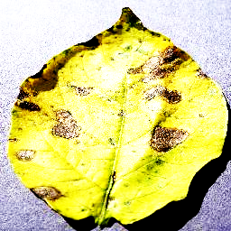
Image correction
Most of the farmers does not have a professional grade camera to take good picture.
So we need to balance color, brightness, saturation and other parameters before feeding it to the deep learning model

Slide 16
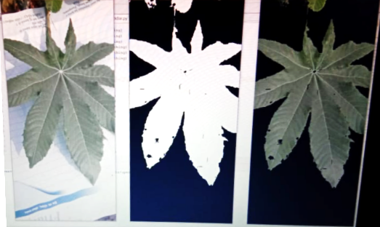
Image segmentation
The data we use is collection of of many different dataset and hence the classes can have a base variance in the background.
We don’t want our model to pick up that false information while classifying, hence segmentation is needed.
This also improves our accuracy of the model

Slide 17
Model, App and Server Side
The model which can classify plant and disease
This model will be loaded onto the android app and will be used on the server side.
The application will provide direct implementation of the model which could either be done locally or on the server side depending upon the situation.
Using server we would be able to do fast processing but client would require active internet connection.

Slide 18
Expected Outcome
An mobile application which takes a picture of plant leaf then classifies the type of the plant.
Further if the leaf has any disease then it also classifies it.
If the disease is detected it searches through internet for remedies to the plant.
This way it is easier for farmers to check if their crop has any disease or not and if it has some then can easily fix it.

Slide 19
Benefits
On device detection of plant disease.
High accuracy for classification of disease with dual layered model.
Fast and precise processing to increase accuracy.
Direct solution to specific disease if connect to internet.

Slide 20
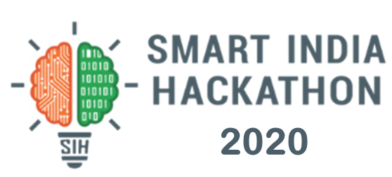
Achievements
Smart India Hackathon 2020 finalists

Slide 21
References
Crop Losses due to pests: Global and Indian Scenario (G.S. Dhaliwal, Vikas Jindal, Bharathi Mohindru)
CONTAINING COVID19 IMPACTS ON INDIAN AGRICULTURE (https://www.icrisat.org/containing-covid19-impacts-on-indian-agriculture)
Android (https://en.wikipedia.org/wiki/Android_(operating_system))
OpenCV (https://en.wikipedia.org/wiki/OpenCV)
TensorFlow (https://en.wikipedia.org/wiki/TensorFlow)
Django (https://en.wikipedia.org/wiki/Django_(web_framework))

